Slide 1
Infinite Dungeon Survival
Hunter Blake, Elliotte Wideman, Chancelor Brown

Slide 2
1. Project Info

Slide 3
2. Game Overview & Vision

Slide 4
3. Core Gameplay Design

Slide 5


4. Game Mechanics & Systems
Top-down 2D twin-stick shooter in dystopian arena combat
Survive enemy waves as they enter the arena from North, South, East, and West walls
Gun & limited AoE attack against drones, robots, and bio-creatures
Earn credits per kill to purchase upgrades from mysterious vendor
Choose between weapon damage, AoE damage, or max health upgrades
Combat emphasizes crowd control and spatial awareness while managing enemies from all directions, dodging projectiles, avoiding laser traps, and making strategic positioning and resource decisions
Notes:
Infinite Dungeon Survival is a top-down 2D shooter where players control a contestant in “The Trials” – an arena competition that pits the down-trodden against waves of futuristic enemy combatants. The gameplay centers on surviving waves of drones, robots, and bio-engineered creatures that spawn from all four directions.
Players use twin-stick controls with two main attacks: a standard gun and a limited-use --- area-of-effect --- ability. Each defeated enemy drops credits, with harder enemies giving more credits.
Between waves, a vendor appears offering three upgrade options: weapon damage, AoE damage, or maximum health. Players spend their credits based on what they need most for their playstyle.
The combat focuses on crowd control and spatial awareness, where the player is managing dozens of enemies coming from all sides while dodging projectiles and avoiding laser traps positioned throughout the arena. Success comes down to strategic positioning and resource management.

Slide 6

5. Narrative, World, & Characters
Year 2099: corporate dystopia with scarce resources hoarded by elites
Players are contestants in "The Trials" - brutal combat entertainment
Fighting for promised freedom and citizenship they'll likely never receive
Arena serves as both mass distraction and propaganda tool
Mysterious vendor: potentially rebellious AI or sympathetic insider
Notes:
The game is set in 2099, where society has collapsed under corporate control. Resources are scarce and controlled by the elite, leaving those at the bottom rung of society to fight for survival.
The player is a contestant who volunteered for The Trials, seeking freedom and citizenship. The Trials serve two functions: they're entertainment for the masses and propaganda that reinforces the ruling party's power.
The core theme is survival against overwhelming odds. There's no win condition - instead, players are measured by how long they last and how many waves they complete.
Between waves, a mysterious vendor offers upgrades. Their identity is unknown - possibly a rogue AI or someone within the system who's sympathetic to the plight of the contestants.
The player's only meaningful choice is how to spend credits between waves. This economic decision represents their one area of control in an otherwise predetermined system.

Slide 7
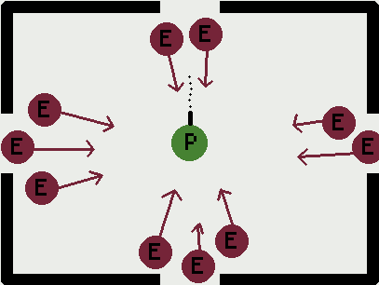
6. Level & Encounter Design
Single sealed arena with enemies from all four directions
Wave-based survival
Success measured by survival duration and waves completed
Laser traps restrict navigable space
Decaying futuristic aesthetics reflect societal collapse
Notes:
The entire game takes place in a single sealed arena. Enemies spawn from all four directions - north, south, east, and west - which creates a confined space focused on crowd control and positioning.
The objective is straightforward: survive each timed wave by eliminating all enemies. Success is measured by survival time and total waves completed.
The gameplay loop is consistent. Players use twin-stick controls to move and shoot while avoiding enemies and projectiles.
After clearing a wave, the mysterious vendor appears for upgrades. Then the next wave begins with increased difficulty.
The arena itself adds hazards through laser traps that limit movement space. If players survive the wave timer, they progress to the next round.
The visual design reinforces the setting – a crumbling infrastructure adorned by flickering neon lights and rusted metal panels that reflects the world's collapse. Cameras are mounted throughout the arena, emphasizing that players are both competitors and entertainment for an audience.

Slide 8
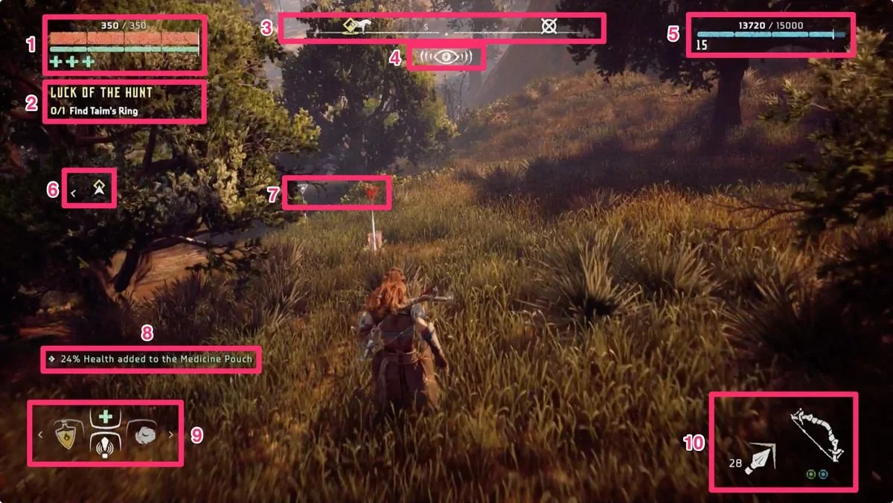

7. UI, UX, & Accessibility
Core Ui Elements:
Health/Shield bar (top-left)
Gold counter & wave timer (top-right)
Ammo & cooldown indicator (bottom-center)
Menus & Screens:
Main menu: Start, Settings, Quit
Pause Menu: Resume, Settings, Return to Main
Upgrade Vender: Upgrade options & cost
GameOver: Displays waves survived, kills, gold
https://www.iabdi.com/designblog/2022/6/1/nier-automata-chips

Slide 9
8.Production Team & Milestones
Team Roles
Elliotte Wideman
Project lead/Programmer/ Docs
Hunter Blake
Narrative Design/ Writing/Ui Ux/programmer
Chancelor Brown
Design Consultant/ Mechanics Testing/ Programmer
Development Milestones:
Pre-Production
(Sep 20 – Oct 5): Brainstorm + GDD
Sprint 1
(Oct 19 – 28): Movement, Shooting, HUG
Sprint 2
(Nov 9 –18): Wave logic, Vendor, Tutorial
Final Build
(Nov 23): Polish + presentation

Slide 10
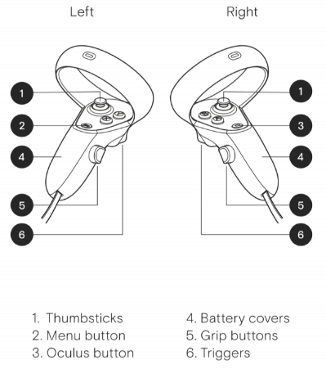
Risks & Out-of-Scope
Risks & Constraints:
Tight timeline and limited team size
Balancing difficulty curve
Hardware or testing issues
Out-of-Scope:
Multiplayer functionality
Procedural map generation
Branching storylines
Add VR/AR compatibility
Reference: image thumbsticks:
https://www.gamearter.com/blog/xr-input-manager-controllers

Slide 11
9. Schedules
Summary:
Pre-Production (Sep 20 – Oct 5): Concept + Setup
Sprint 1 (Oct 19 – 28): Core Mechanics
Sprint 2 (Nov 9 – 18): Systems + UI Integration
Deliverables (Nov 14 – 17): Poster Draft / C-Day Submission
Final Build (Nov 23): Polish and Release

Slide 12
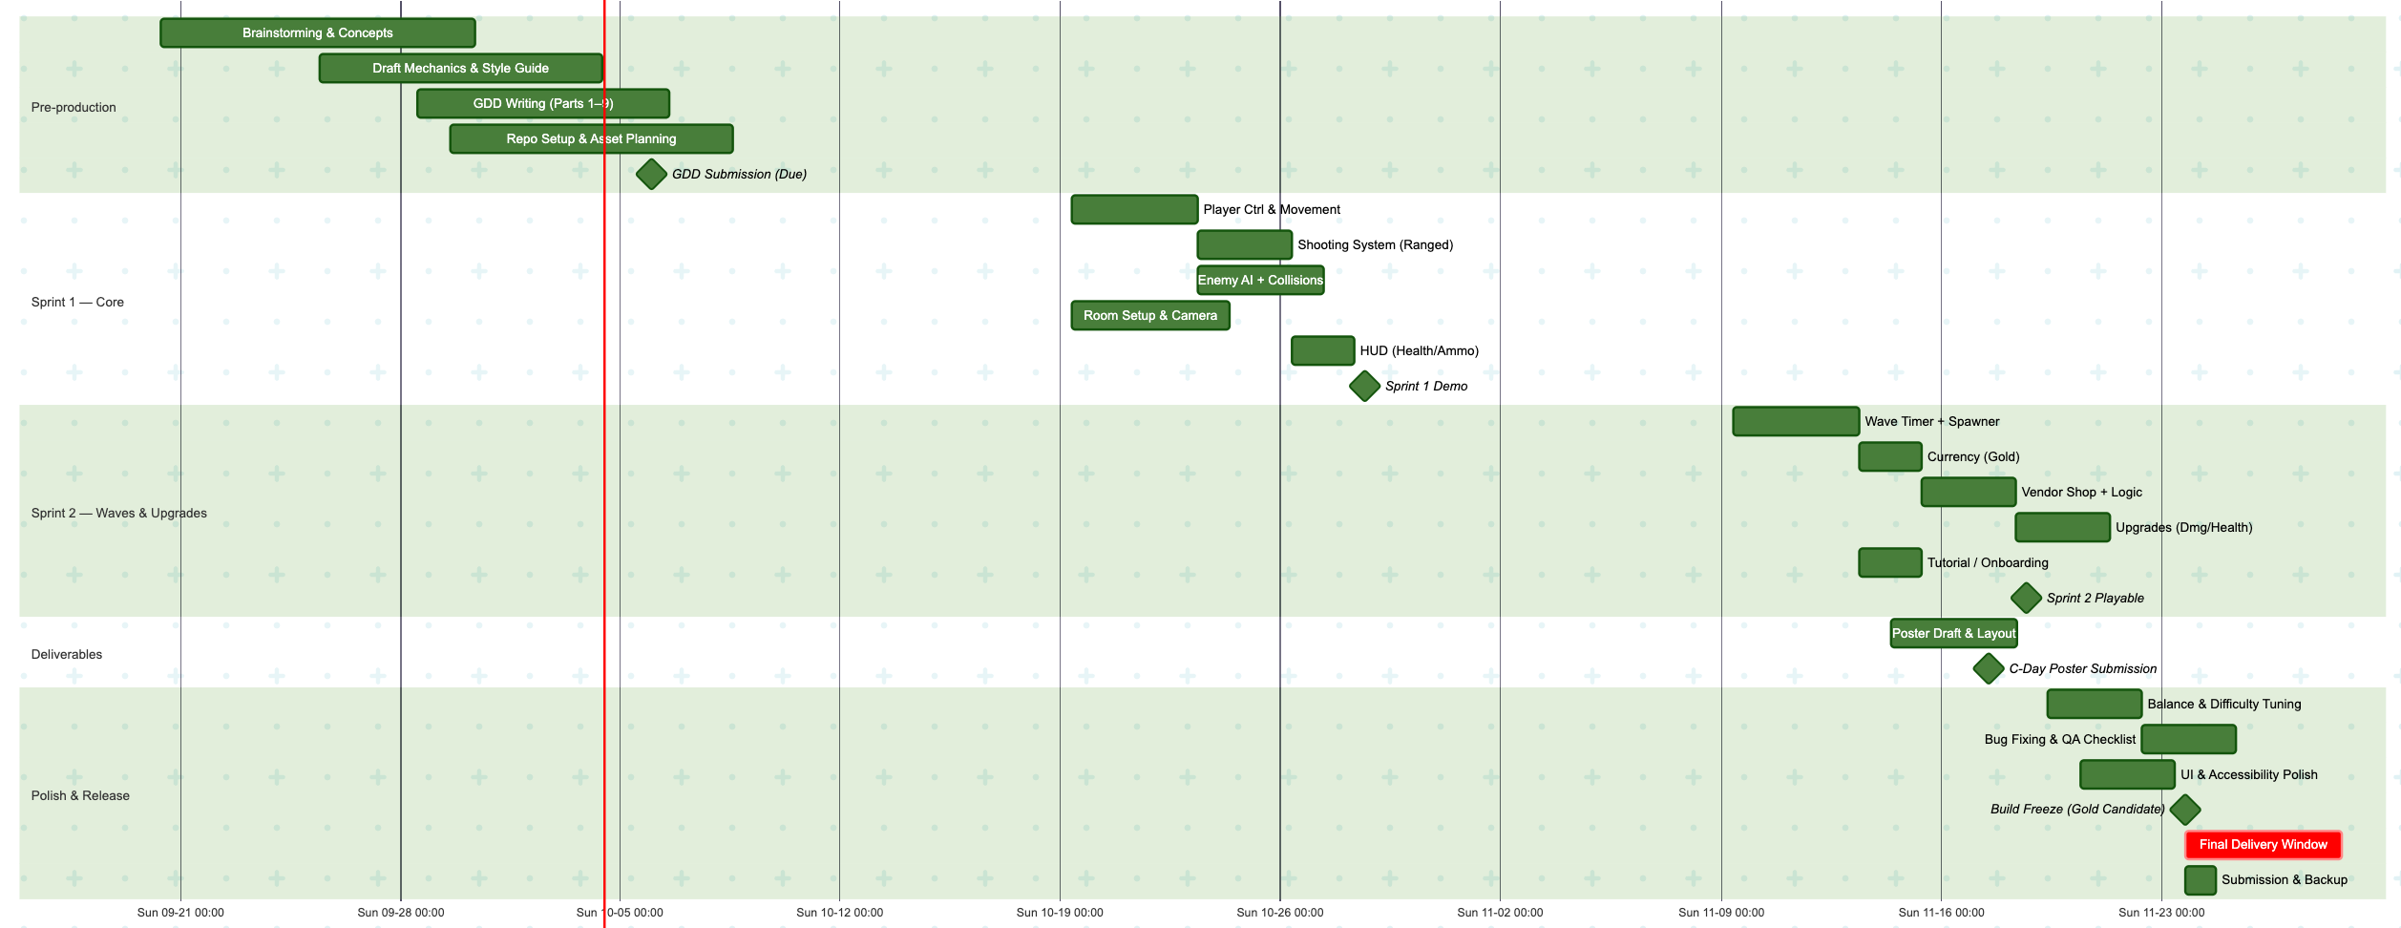
Gnatt Chart

